Slide 1
How to Give a Good Talk

Slide 2
Be Active!
Make your own opinion
Attend presentations
Mimic presentations you understand/like
Never ever consider simplicity and clarity as a proof of weakness
Never forget that you can violate the rules if you have any good reasons to do so

Slide 3
Outline
Why should you bother doing talks?
How to structure your talk?
How to make your slides?
How to give your talk?
Great talks examples

Slide 4
Presentations are a fundamental part of research excellence

Slide 5
Research and Marketing
The best researchers in the world learned how to sell their work
To the community
Visibility, impact
To students
Attract graduate students
To commissions
Funding, promotion
To the public
Increase attraction of your field, fame

Slide 6
Goals of a Presentation
Give the audience the intuition of your idea
Make the audience eager
To read your paper
To ask you questions
To discuss with you
Build relationship
Create a reputation
Get feedback

Slide 7
Goals of a Presentation
Show you can make great presentations
Big plus in a career
Conversely, a poor presentation can kill an application to a new position

Slide 8
Outline
Why should you bother doing talks?
How to structure your talk?
How to make your slides?
How to give your talk?
Great talks examples

Slide 9
Adapt to the Audience
The entire audience must understand your talk
It is better to explain notions a part of the audience already knows than to lose another part of the audience during the talk
Do not overestimate the knowledge of the audience in your field

Slide 10
Do Not Present Too Much
Common pitfall
“I did a lot and I will present every single bit of my work. They will be impressed!”
That shows you are unable to deliver a message
Do not hesitate to cut your results
It is better to present 10% of your work that the audience understands than 90% that nobody understands

Slide 11
Do Not Present Too Much
The audience will remember at most one single message
Don’t sell more, but sell it well
Yes, it is marketing
Useless to do great research if nobody knows about it

Slide 12
Give a Structure to Your Talk
Give a background
Adapt to the audience
Adapt the technical granularity of your presentation
Motivate your work
Why is the subject important and interesting?
Focus of your work
What is this presentation/work about in a single sentence? What is the problem?

Slide 13
Give a Structure to Your Talk
Show methodology and tools
Show results
Clearly show your contributions
Conclude with a summary of contributions
Impact of this work
Future work rarely makes sense unless you are really planning future work

Slide 14
Give a Structure to Your Talk
Give an outline
You can give it first before or after (better) the background
Repeat the outline before each new part
Use color to show where you are
Make clear the structure of your talk to the audience
No suspense

Slide 15
Give a Structure to Your Talk
No need to go deep into related work (unless it is a survey)
Your contributions must be the core
But, be prepared to discuss related work

Slide 16
Alternate Structures
You need to know what you are doing
More original means more risks
Alternate questions and answers
Appropriate for tutorials and general talks
Less appropriate for technical talks

Slide 17
Alternate Structures
No slides
Need to be a very strong speaker
Need a very well structured presentation
Need a very high effort from the audience
You must transmit energy
Some (lazy) people don’t like such presentation

Slide 18
Make Summaries
For each important result
At the end of each part of your talk
Clearly show the take home messages

Slide 19
Anticipate Q&A
Prepare backup slides
Very impressive when it works
You can put technical details or results you did not have time to address in them
Be prepared to answer questions
Rehearse with colleagues
Be prepared to hard questions

Slide 20
Outline
Why should you bother doing talks?
How to structure your talk?
How to make your slides?
How to give your talk?
Great talks examples

Slide 21
Slide Template
Avoid overloaded templates
Frequent with some companies that like to justify a costly graphical identity
Unless you have a graphical talent, keep it simple
Make a clear distinction between the title and the rest
Do not use complex headers or footers
No need to give the presentation title, affiliation, authors list, company logo, etc. on each slide
Décembre 2011
-

Slide 22
Use Slide Numbers
How do you know which slide it is over 22?
“The slide whose title is ‘Use Slide Numbers’”
“The slide after ‘Slide Template’”
“I don’t remember, go back, again, again, again, again, stop… yes this one!”
Used to ask questions and to answer
Used during audio or video conferences
At least 20 pt
Even at the back someone may ask a question

Slide 23
Use non-serif fonts (times)
Serif fonts are hard to read
Line width is not uniform
Thin lines may not render well with all projector types
Hard to read from the back
Use
Comics: might look childish
Arial: looks formal, very (may be too) popular
Calibri: good alternative to arial

Slide 24
Use non-serif fonts (comics)
Serif fonts hard to read
Line width is not uniform
Thin lines may not render well with all projector types
Hard to read from the back
Use
Comics: might look childish
Arial: looks formal, very (may be too) popular
Calibri: good alternative to arial

Slide 25
Use non-serif fonts (Arial)
Serif fonts hard to read
Line width is not uniform
Thin lines may not render well with all projector types
Hard to read from the back
Use
Comics: might look childish
Arial: looks formal, very (may be too) popular
Calibri: good alternative to arial

Slide 26
Use non-serif fonts (Calibri)
Serif fonts hard to read
Line width is not uniform
Thin lines may not render well with all projector types
Hard to read from the back
Use
Comics: might look childish
Arial: looks formal, very (may be too) popular
Calibri: good alternative to arial

Slide 27
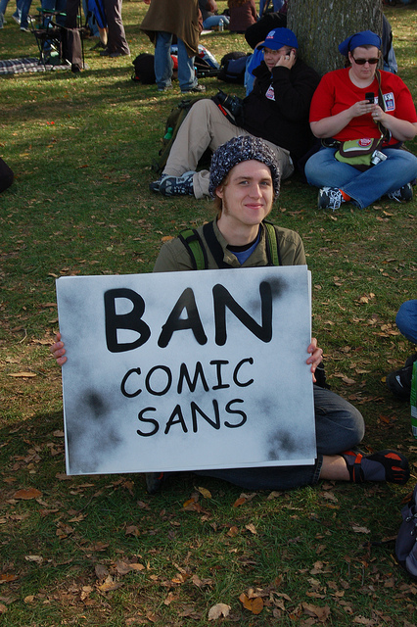
The Ban Comic Sans Campaign
Some people hate the comic sans font
http://bancomicsans.com
Reasons
Ubiquitous
Childish, immature, naïve, etc.
Inappropriately used (e.g., military)
May be, because it comes from Microsoft

Slide 28
The Ban Comic Sans Campaign
What to do
Be aware you might upset the audience
Is it worth taking the risk?
Don’t use it for a job application
Your teachers used it in his/her lectures?
Looks less scary than Arial for students
It is subjective
Calibri Preferred!
It is very rare today in academic presentations

Slide 29
Use Large Fonts
Font must be larger than 20pt (here it is 32pt)
Font must be larger than 20pt (here it is 24pt)
Font must be larger than 20pt (here it is 20pt)
Font must be larger than 20pt (here it is 18pt)
Font must be larger than 20pt (here it is 16pt)
Font must be larger than 20pt (here it is 14pt)
Where do you stop to read it from the back?
Consider poor projectors, poor screens, poor eyes

Slide 30
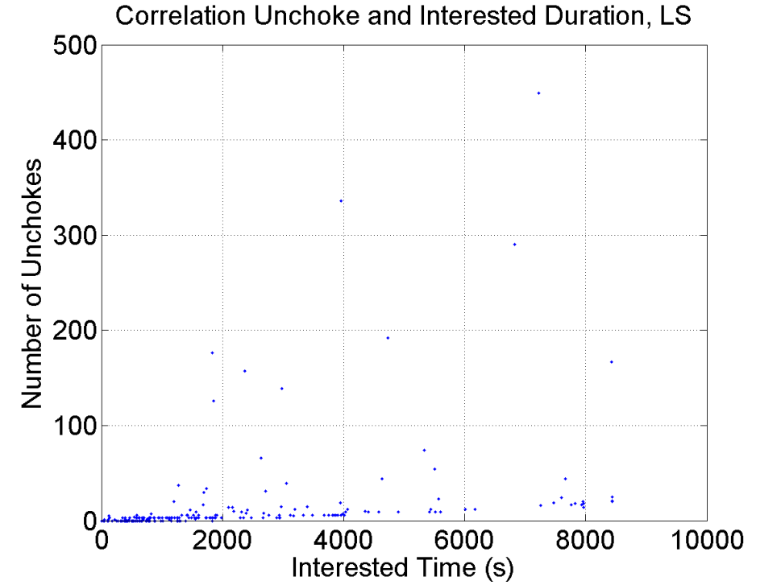
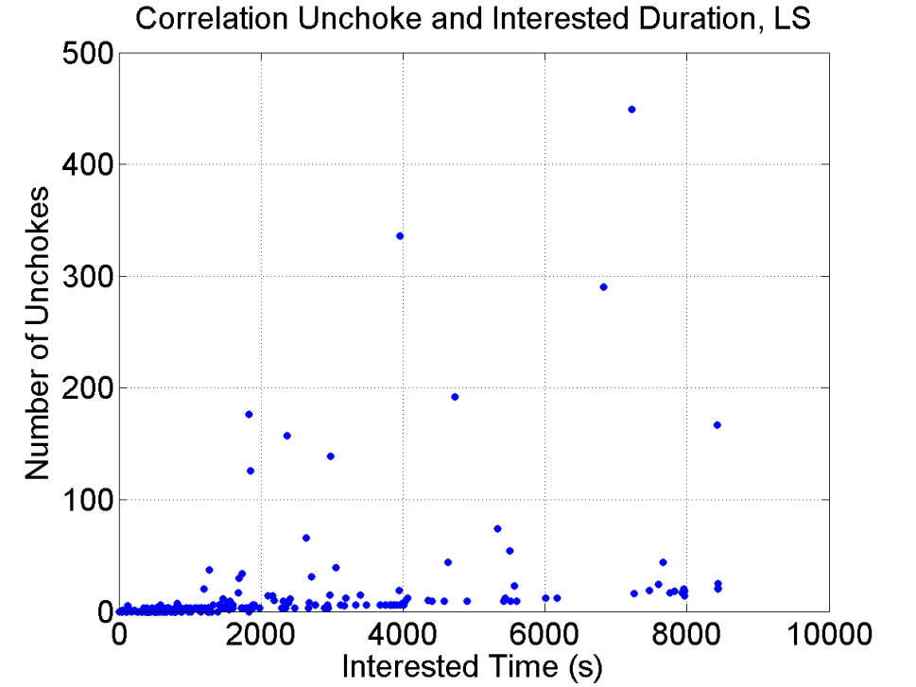
Show Readable Figures
Use large symbols

Slide 31
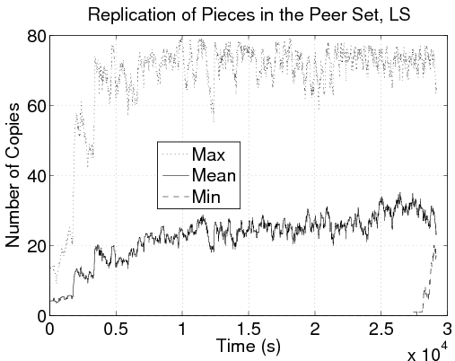
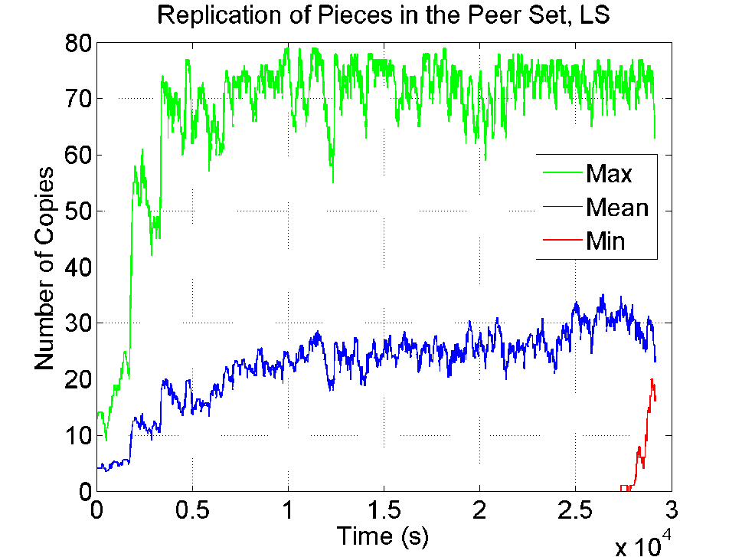
Show Readable Figures
Use thick solid lines and colors

Slide 32
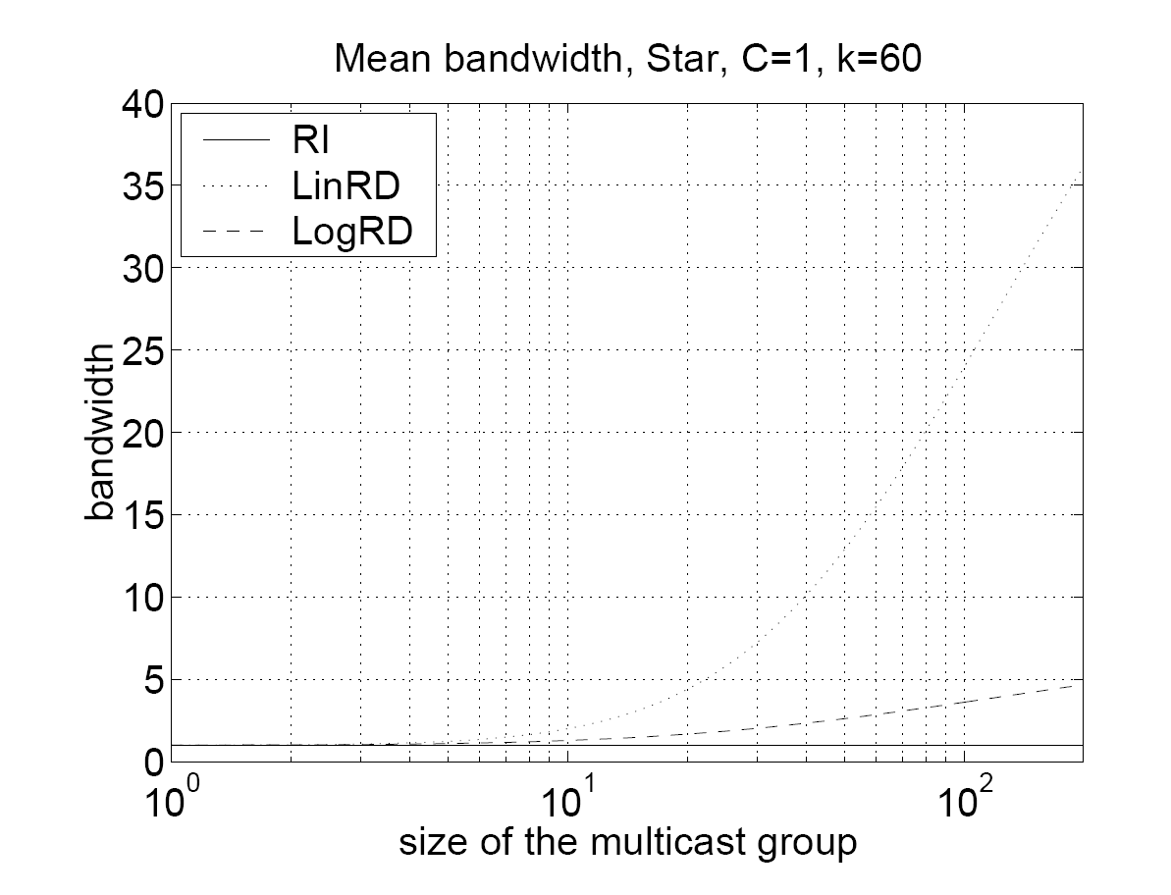
Show Readable Figures
Do not use the camera ready figures
Often unreadable on slides

Slide 33
Be Concise
Do not write complete sentences as they make your message obfuscated in long lines of text
Never forget that nobody can read your slides and listen to you at the same time unless you are reading what is in your slides. But, you must not read your slides, this is boring
Omit technical details, there is no chance to explain everything in a single presentation. Instead, you should make the audience eager to read your work
Do not believe complexity will impress your audience, it will simply make you look unable to express your idea

Slide 34
Be Concise
Write small sentences
Do not compete with your slides
You give the message, the slides support it
Do not dig into details
Just deliver a message
Give a preview of your work/paper
Be simple in your explanations

Slide 35
Use Illustrations
Make your point clear and simple
Give a mental image people are more likely to remember
Always use a figure instead of a table

Slide 36
Without Illustrations (Poor)
Prior to distribution
Content split multiple pieces
Metainfo file created by the content provider
To join a torrent
Peer P retrieves metainfo file from a well-known website
P contacts the tracker
The tracker responds back with a peer set of randomly selected peers
P contacts peers in this set and start requesting different pieces of the content

Slide 37
With Illustrations (Better)
coolContent.torrent
Web server
random peer set
Tracker
coolContent.xvid
P1
P2
P3

Slide 38
How Many Colors?
No more than three colors on a slide
Here I have four
Use easy to distinguish colors like dark
Blue, Red, and Green
Use colors to emphasize an important word
May be used to remind you to develop keypoints

Slide 39
How Many Colors?
No more than three colors on a slide
Here I have three
Use easy to distinguish colors like dark
Blue, Red, and Black
Use colors to emphasize an important word
May be used to remind you to develop keypoints

Slide 40
Background Colors
Never use light colors or low contrast
They may not render well
No
Never use light colors or low contrast
They may not render well
No
Never use light colors or low contrast
They may not render well
Yes
Never use light colors or low contrast
They may not render well
Yes

Slide 41
Background Colors
I like this one
Quite relaxing to look at such slides
Looks clean and simple
Seems to work well with colors too
Red, Blue, Green (favor light colors)
Be careful with contrast
When there is light in the room, contrast is lower
You don’t have control on it, consider the worst case

Slide 42
Background Colors
Don’t use thin fonts
They may not render well
I don’t have much experience with this background
Seems to become more popular
Try it and make your own opinion

Slide 43
Colors and Projectors
The universal rule
Projectors never render colors as you expect
Be prepared to
Red that looks pink or orange
Blue that looks purple
Yellow that is invisible (never use yellow)
Never use colors that are too close
Dark green, red, and blue is the safe side

Slide 44
Do Not Over Illustrate
Do not use
Irrelevant illustrations
Weak metaphors
Animated images

Slide 45
Do Not Over Animate
It is disturbing
Annoying
Useless
You cannot keep the audience focused

Slide 46
Use Semantic Animations
Use with caution

Slide 47
Use Enlightening Animations
Animations must make complex idea simple to grasp
No magic, it is a lot of work to make
Here are two examples

Slide 48
Use Enlightening Animations: P2P case
P2P
Client-server

Slide 49
Use Enlightening Animations: Sieve of Eratosthenes
A number is prime if it can only be divided by 1 or by itself
2 3 4 5 6 7 8 9 10 11
12 13 14 15 16 17 18 19 20 21
22 23 24 25 26 27 28 29 30 31
32 33 34 35 36 37 38 39 40 41
42 43 44 45 46 47 48 49 50 51
52 53 54 55 56 57 58 59 60 61
62 63 64 65 66 67 68 69 70 71

Slide 50
Use Enlightening Animations: Sieve of Eratosthenes
2 3 4 5 6 7 8 9 10 11
12 13 14 15 16 17 18 19 20 21
22 23 24 25 26 27 28 29 30 31
32 33 34 35 36 37 38 39 40 41
42 43 44 45 46 47 48 49 50 51
52 53 54 55 56 57 58 59 60 61
62 63 64 65 66 67 68 69 70 71

Slide 51
Use Enlightening Animations: Sieve of Eratosthenes
2 3 4 5 6 7 8 9 10 11
12 13 14 15 16 17 18 19 20 21
22 23 24 25 26 27 28 29 30 31
32 33 34 35 36 37 38 39 40 41
42 43 44 45 46 47 48 49 50 51
52 53 54 55 56 57 58 59 60 61
62 63 64 65 66 67 68 69 70 71

Slide 52
Use Enlightening Animations: Sieve of Eratosthenes
2 3 4 5 6 7 8 9 10 11
12 13 14 15 16 17 18 19 20 21
22 23 24 25 26 27 28 29 30 31
32 33 34 35 36 37 38 39 40 41
42 43 44 45 46 47 48 49 50 51
52 53 54 55 56 57 58 59 60 61
62 63 64 65 66 67 68 69 70 71

Slide 53
Use Enlightening Animations: Sieve of Eratosthenes
2 3 4 5 6 7 8 9 10 11
12 13 14 15 16 17 18 19 20 21
22 23 24 25 26 27 28 29 30 31
32 33 34 35 36 37 38 39 40 41
42 43 44 45 46 47 48 49 50 51
52 53 54 55 56 57 58 59 60 61
62 63 64 65 66 67 68 69 70 71

Slide 54
Be neaT
Do YOU like
slides with sppell check erors
Inconsistant:
Capitalisation
Bullet.
Struture,
font;
Ugly slides
poor use of symbol !!!
Poor layout

Slide 55
Be Neat
Do you like
Slides with spell check errors
Inconsistent
Capitalization
Bullets
Structure
Font
Ugly slides
Poor use of symbols
Poor layout

Slide 56
No Punctuation Mark.
No punctuation mark:
At the end of sentences:
Period (.) ,
Colon (:),
Semi-colon (;),
Comma (,).
Apart from:
Question marks (?),
Exclamation marks (!).

Slide 57
No Punctuation Mark
No punctuation mark
At the end of sentences
Period (.)
Colon (:)
Semi-colon (;)
Comma (,)
Apart from
Question marks (?)
Exclamation marks (!)

Slide 58
Use Meaningful Titles
The title should summarize the slide content
Do not use a same title with an increasing number
Introduction 1/5
Introduction 2/5
Etc.
Poor variant “cont.”

Slide 59
Outline
Why should you bother doing talks?
How to structure your talk?
How to make your slides?
How to give your talk?
Great talks examples

Slide 60
How to Show Something on a Slide?
You can touch the screen
Really touch the screen
Don’t shake the hand 5 meters in front of the screen
Not always possible
Screen might be too high or too far
Not the most professional solution

Slide 61
How to Show Something on a Slide?
You can use neat animations
Works in any case
Many excellent options
Square, circles, ovals, arrows, etc.
See examples in the following
But, never use a laser pointer
Always disturbing
Aren’t you shaking?

Slide 62
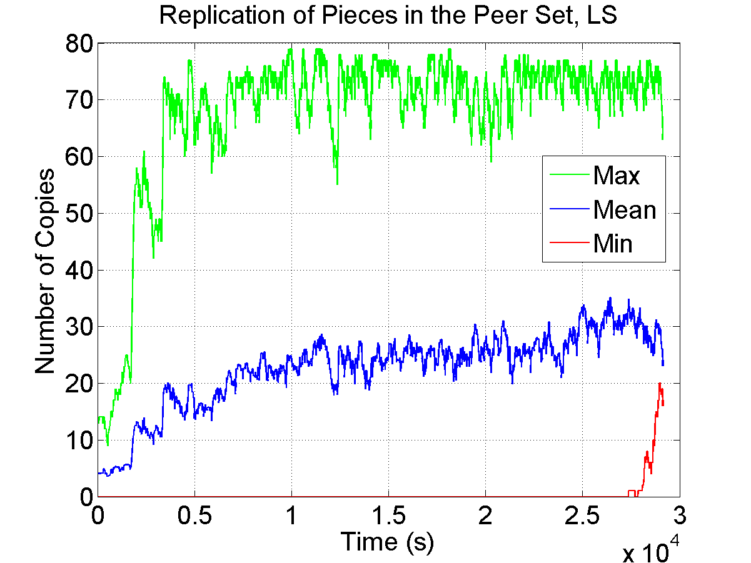
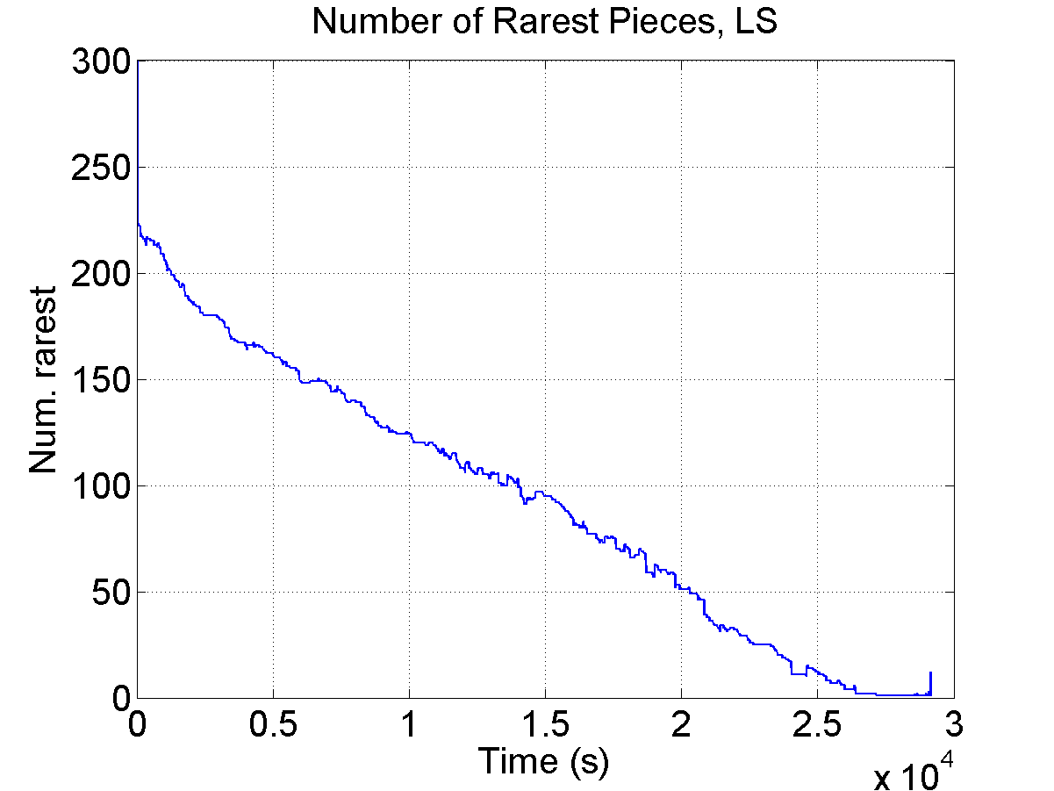
Use Thick Lines
36kB/s

Slide 63
Use Arrows
11.6 PB
41% savings
Cumulated inter-AS traffic (TB)
56% savings
Torrent ID (sorted by decreasing inter-AS traffic, log scale)

Slide 64
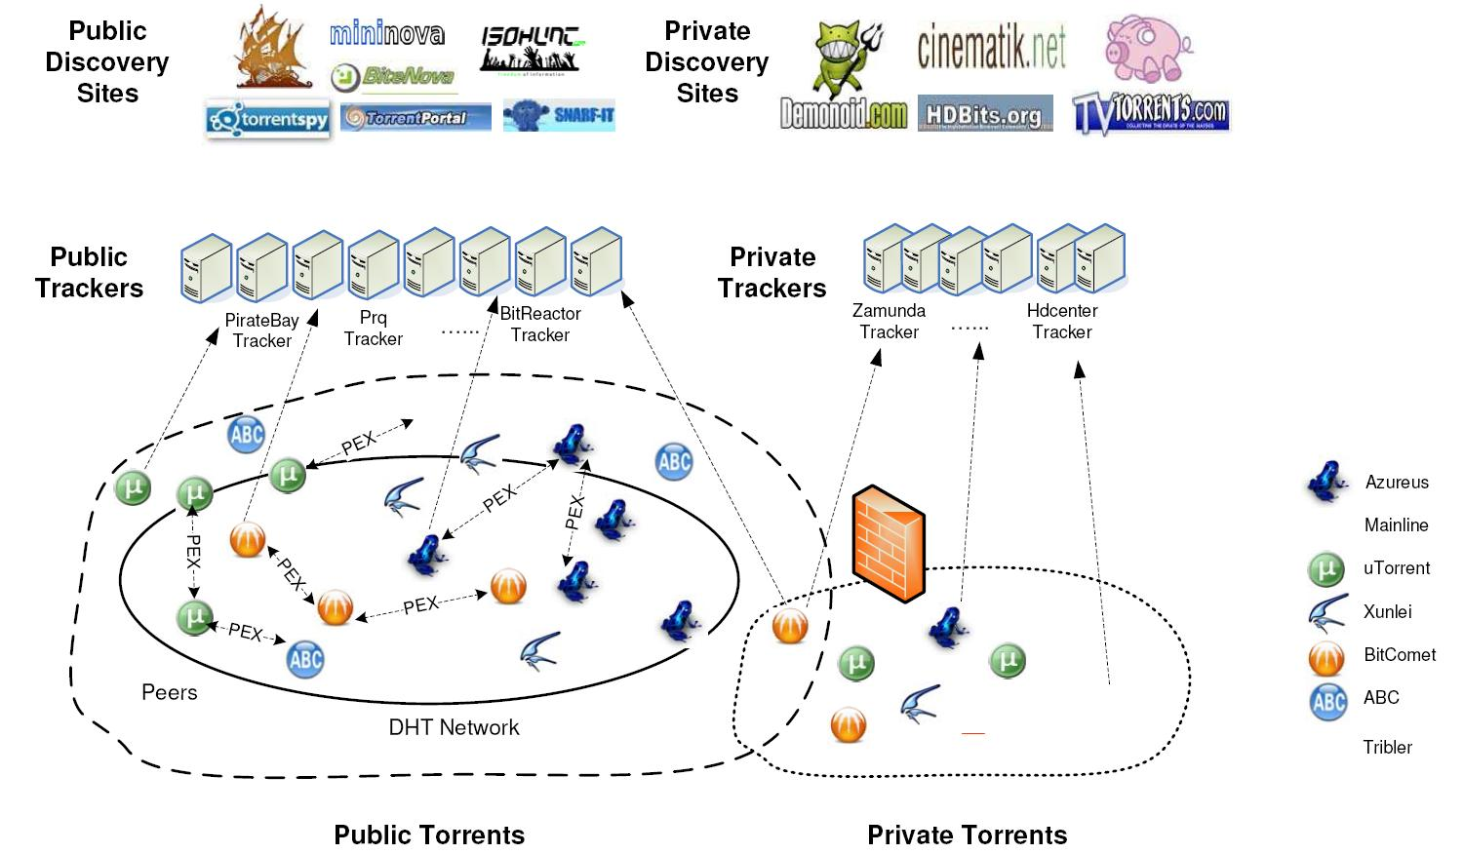
Use Semi-Transparent Squares
Focus of [42]

Slide 65
Explain All Slides
Never present a slide you do not explain in details
Always drop a slide if you present it for less than 30 seconds
Spend time on complex figures or drop them
Spend time on equations or drop them
Talk on transition slides (e.g., outline reminders) or drop them
Use transition to summarize the previous part and introduce the next one

Slide 66
Minimum Explanation
For each figure you must
Give for each of the x-axis, y-axis, and z-axis
Label, unit, scale (if log scale)
Give the legend
Explain all symbols
Take an example to illustrate a specific point in the figure
Very useful if the figure is complex

Slide 67
Minimum Explanation
For each equation you must
Explain all variables and parameters
If you cannot
Drop the figure or the equation, otherwise it will be useless

Slide 68
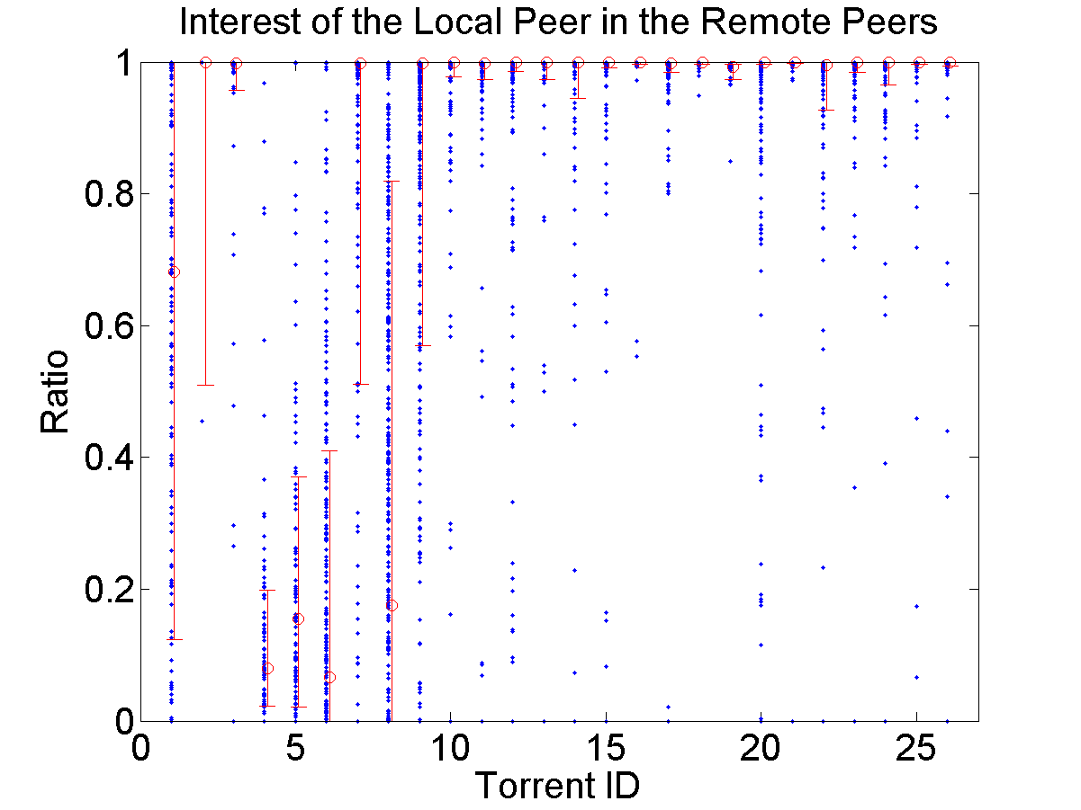
Example for a Figure
High peer availability
0 to 1 seed
3 to 12612 seeds
Increasing peer availability
80th
Low peer availability
50th
20th
Increasing number of seeds

Slide 69
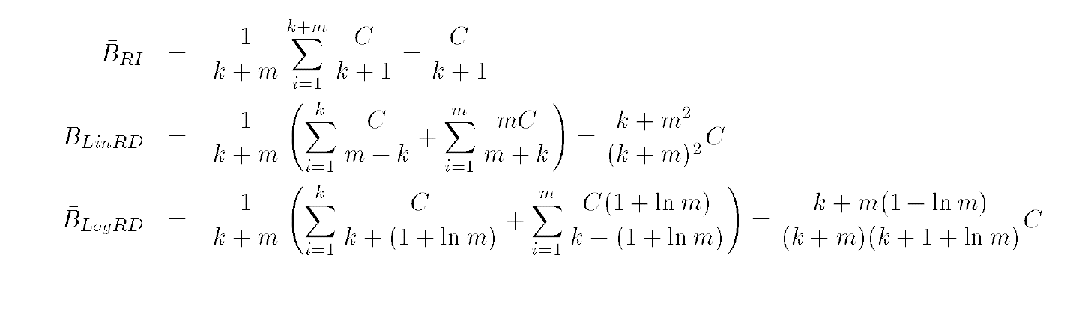
Example for an Equation

Slide 70
But, Prefer the Figure to the Equation

Slide 71
Introduce and Summarize Slides
For each important slide
Say a one sentence introduction
What you are going to discuss now
Say a one sentence summary
If the audience has to remember a single sentence it is this one
For very important results, show the take home message

Slide 72
Be Redundant
Repeat several times
I’m going to explain…
My explanation is…
I just explained…
Never too much redundancy

Slide 73
Never Go Back
It is bad habit to go back to a previous slide
If you forgot something, just tell it
If you need a previously shown image, add it again
Navigating within slides will lose your audience

Slide 74
Never Exceed Your Allocated Time
This is a lack of respect for the audience and the next speakers
Not admissible, not professional
Should never happen if you are well prepared

Slide 75
Never Exceed Your Allocated Time
In case you feel you will exceed the allocated time
Drop slides
No problem to drop a full part
Never drop summary of contributions
Never stop in the middle of somewhere

Slide 76
One Slide Every Two Minutes
Usually everybody agrees
Now, count!
10 minutes means 5 slides
20 minutes means 10 slides
How many slides do you have for a 20 minutes talk?

Slide 77
One Slide Every Two Minutes
You can violate this rule if
You have time to explain in details all slides
You will not exceed your allocated time
You will not speak much faster
Hard to spend on average per slide
less than 1 minute (really short)
more than 3 minutes (start to be SB)
So boring! Not Smart boy.

Slide 78
Use a Watch
On a room wall, in front of you
You can see it, but not the audience
On your desk
Digital one with large enough numbers
On PowerPoint
Presenter mode
Very convenient, you can get comments and a few slides before and after the current one

Slide 79
For Long Talks
Several hours to several days
Make summary at the end of each part
Every hours and after each break
Involve the audience
“Jon, what do you remember from the last hour?”
“Jim, can you in few words explain me this part?”
But, don’t be too pushy: it is not an exam!

Slide 80
Q&A
Reformulate questions
Make sure you understood them
Make sure everybody hear them
Be concise in your answer
Do not start a discussion
“I propose to continue this interesting discussion during the break. Another question?”

Slide 81
Q&A
Never bluff or lie
Acknowledge when you don’t have the answer
“Thank you for that point, I don’t have an answer now. We will definitely look at it.”
“I don’t know this article, but it looks similar to what we did. Can you send me the pointer?”
Never forget to send back your answer by email

Slide 82
Q&A
Questions might be
Aggressive
Stupid (most of the time, such questions show you made a poor presentation)
Hard to answer
Showing you are wrong
In any case never
Lie, aggress, or complain

Slide 83
Q&A
During a conference, if you don’t understand the question
Try to reformulate based on what you got
If after one try you still don’t understand it
Ask the session chair
If after two tries nobody got it
Don’t start a discussion at that point
Propose to take it off-line after the talk

Slide 84
Use Your Body
Use eye contact
Do not stare (no more than 10 seconds)
Do not avert or switch fast
Use your hands
To support visually what you say
You can walk, but
Do not stand in front of your slides
Do not continuously walk along a line
Walk on a triangle and stop at each vertex

Slide 85
Use Your Body
Stay in front of the audience
Aside the slides, but not in front of them
Do not show your back or your side
Do not persistently move while speaking

Slide 86
Use Your Voice
Make a short pause before each important message
In the order of a few seconds
Pauses are even more effective than raising voice
The rhythm of the speech is what makes a big difference to catch the attention

Slide 87
Use Your Voice
Vary your voice level
Speaking softly catch better the attention than speaking even louder
Alternating loud and soft speech catch the best the attention
You need to practice a lot to find the right balance
My rule of thumb
Make a pause and speak softly before a very important result
Never read your slides or notes

Slide 88
Show Enthusiasm
If you don’t show enthusiasm presenting you own work, do you really believe that the audience will be enthusiastic
Listening to you
Reading your work
Inviting you
Discussing with you

Slide 89
Use a Second Screen
Do not look at your slides on the primary screen
You must not show your back to the audience
Hard to keep the eye contact this way
Use instead a second screen (in clone or extended view)
Place it appropriately
Stay in front of the audience when you look at the slides
Hard to see you are looking at the slides

Slide 90
Practice
Best speakers are the ones who practice the most
No improvisation or spontaneity
To look spontaneous you even need to practice more
Stand up and speak with loud voice to practice
Practice at least once using a projector
Practice with colleagues (once well trained)
The shorter the talk the more you have to practice
Be prepared to answer hard/aggressive questions

Slide 91
Practice
To prepare a 20 minutes talk
Three days for a first version of the slides
Around 10 rehearsal in front of my desk
Around 5 “in situation” rehearsal
Final version of the slides
Stand up
Speak loud
May use a real projector
Stringent time constraint
In front of colleagues

Slide 92
Outline
Why should you bother doing talks?
How to structure your talk?
How to make your slides?
How to give your talk?
Great talks examples

Slide 93
Wonderful Examples
General talks (not scientific)
Randy Pausch Last Lecture (in english)
How to communicate passion?
Try http://www.youtube.com/watch?v=ji5_MqicxSo
Or search google for “Randy Pausch Last Lecture”

Slide 94
Wonderful Examples
General talks (not scientific)
Michel Serres aux 40 ans de l’INRIA (in french)
How to keep the audience focused during one hour without any slides and sitting at a chair?
Try http://www.inria.fr/40ans/forum/video.fr.php
On the same site you will find horrible presentations

Slide 95
Wonderful Examples
Scientific talks
Gerard Berry (Collège de France)
In French: http://www.college-de-france.fr/default/EN/all/cha_inf2009/Lecon_inaugurale_du_19_novembr.jsp
More talks (some in English) here: http://www-sop.inria.fr/members/Gerard.Berry/

Slide 96
Wonderful Examples
Watch talks on http://www.ted.com/
Extremely high quality standard
Elizabeth Gilbert on nurturing creativity
http://www.ted.com/talks/elizabeth_gilbert_on_genius.html

